Slide 1
BRIDG Update
RCRIM Working Group Meeting
Rio de Janeiro
17 May 2010
Julie Evans
Senior Director, Technical Services, CDISC
Wendy Ver Hoef
Senior Analyst, ScenPro, Inc., Contractor to National Cancer Institute

Slide 2
BRIDG Basics
BRIDG Purpose:
“A collaborative effort to produce a shared view of the dynamic and static semantics that collectively define a shared domain-of-interest in order to achieve computable semantic interoperability in that domain.”
Domain-of-interest (Scope):
“Protocol-driven research and its associated regulatory artifacts, i.e. the data, organization, resources, rules, and processes involved in the formal assessment of the utility, impact, or other pharmacological, physiological, or psychological effects of a drug, procedure, process, subject characteristic, or device on a human, animal, or other subject or substance plus all associated regulatory artifacts required for or derived from this effort, including data specifically associated with post-marketing adverse event reporting. ”
Stakeholders: CDISC, HL7, NCI, FDA
Process:
  Board of Directors prioritizes projects and Semantic Coordination Committee consults with projects and harmonizes project models into main model with help of project analysts/SMEs

Slide 3
Current Harmonization Projects
RCRIM: CTR&R
NCI:
  C3PR – caBIG Clinical Central Participant Registry
  PSC – Patient Study Calendar
  LabViewer
  caAERS – caBIG Adverse Event Reporting System

Slide 4
Update on Request for BRIDG DMIM Candidate
Basic model largely built, but requires alignment with other committees
Not yet in a reviewable state, but expected to be done with first draft in a month or two
Includes a list of changes to propose for existing CMETs to handle BRIDG semantics not yet covered (e.g. add moodCode options in Clinical Statement CMET to allow for study design, etc.)
Will update RCRIM on a future concall

Slide 5
ISO JIC Approval Process Results
ISO Ballot - Approved
HL7 Ballot - Approved
CDISC Review and Comment Process – review and comment period completed

Slide 6
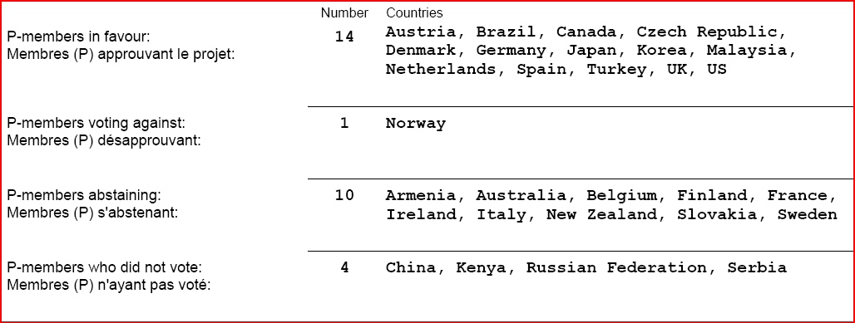
ISO Ballot Results – 3 Comments

Slide 7
HL7 Version 3 Domain Analysis Model: BRIDG, Release 1 (Informative 1) – 254 Comments
Affirmatives: 46
Negatives: 24
Abstains: 41
No Votes: 28
Total People in Pool: 139
Quorum Level: 79.86%
Affirmatives Needed to Provisionally Pass: 42

Slide 8
Comment by Vote Type
Vote Type | Count
Negative Major | 4
Negative Minor | 76
Affirmative (suggestion, comment, question, comment) | 107
Untyped | 72

Slide 9
CDISC Review and Comment Process
No outstanding comments attributed to CDISC

Slide 10
Categorization of Comments
Category | Number
Already in Model | 1
DAM Boundary | 3
Diagram Change | 1
Editorial – Addition | 13
Editorial – Clarification | 78
Modeling Correction | 29
Modeling Issue | 15
Process | 7
Professional Difference of Opinion | 11
Proposed New Content | 68
Question | 21
Typo | 10
About 80 have an initial resolution

Slide 11
Plan
Initial triage into categories - Done
Resolve all comments – In progress
Review dispositions with commenters
Update model and documentation
Release ISO DIS and HL7 normative ballot
  Phased to be coterminous

